Slide 1
Test Requirements for Commercial PiezoMEMS
Joe Evans, Bob Howard, Scott Chapman, Spencer Smith, Michelle Bell
Radiant Technologies, Inc.
2018 International Workshop on Acoustic Transduction Materials and Devices
May 8, 2018

Slide 2
Introduction
Radiant is preparing for the advent of electronic circuits and systems containing embedded ferroelectric capacitors, sensors, and actuators.
Test systems must not only execute traditional ferroelectric tests but must also communicate with and control digital and electromechanical circuits in these emerging systems plus their fixtures.
The objective of this presentation is to introduce the architecture Radiant will use for its new pMEMS tester that will evaluate not just ferroelectric devices but also the systems in which they are embedded.

Slide 3
Design Goal
A fully functional Precision Multiferroic with additional I/O and new measurement channels to allow Vision to simultaneously control a test fixture, the control circuits surrounding a ferroelectric device, and the embedded ferroelectric device itself.

Slide 4
Contents
Examples of circuits and systems built by and tested at Radiant.
Long Term Reliability of matched capacitor pairs.
Stand-alone Ferroelectric Memory.
pMEMS Resonators.
Test Requirements for embedded ferroelectric systems.
New Tester Architecture and Accessories.
New Vision Tasks and Filters.

Slide 5
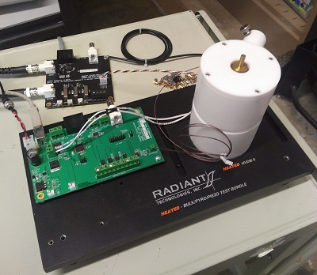
Example: Long Term Reliability
Radiant combined spare parts from different products to create an automated, dual-capacitor, simultaneous imprint/fatigue, thermal chamber
operated by a tester.

Slide 6
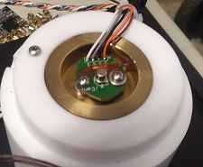
Custom Test Fixture
PNDS TO-18 Board
DRIVE/RETURN
PNDS 2-Channel Mux
Thermocouple
I²C
Dual capacitors in a single TO-18 package
Radiant will introduce a commercial version of this fixture at the end of 2018. It will fully integrate with Radiant’s pMEMS tester for automated testing under Vision control.
USB
Power
Original HVTF modified for optical heating.
Thermal Controller from the HVDM II
Already tested packages

Slide 7
Fixture Diagram
I²C
RETURN
DRIVE
PNDS Mux
TC
Chamber
USB
Thermal
Controller
PWR

Slide 8
Test Procedure
Program Vision to execute a Retention Test on two capacitors simultaneously but also capture their Opposite States at each retention measurement point.
Set Temperature
Apply UP pulse to Capacitor A
Apply DOWN pulse to Capacitor A
Retain for specified period.
Apply UP pulses to Capacitor A and B to measure retention.
Apply preset pulses and then measurement pulses for Opposite States.
Repeat cycle for long retention period.

Slide 9
Results: Imprint Characterization
Simultaneous 85°C opposite-state curves (red) for two capacitors for 24 hours. Results indicate potential >30 years imprint lifetime .
Blue = Retention
Red = Imprint
Retention Results: PZT never forgets!
30 years

Slide 10
Results: Imprint vs Process
The two capacitors compared below were fabricated at the same time using the same sol gel but with different processes.
Blue = Process Adjustment
Red = Original Process
30 years

Slide 11
Results: Imprint vs Composition
The three capacitors compared below were of the same 20/80 PZT base composition but two were
Blue = 2/20/80 PNZT
Red = 2/20/80 PLZT
Black = 0/20/80 PZT
30 years

Slide 12
Example: Ferroelectric Memory
A ferroelectric capacitor in a classic RC circuit exhibits extraordinary electrical properties.
C = 400 µm² 2600Å-thick 20/80 PZT
R = 15MΩ
Measured
UP
DOWN
V_{out}
The “Shelf” Voltage.

Slide 13
Test Circuit
Testing long term reliability of this memory circuit requires an asynchronous voltage pulse from the I²C DAC to set the DOWN state but synchronous writes and reads to determine the memory state.
Power
DRIVE
R_{Sense}
Tester
C_{FE}
Output
+15V
+
SENSOR
R_{Base}
C
-
I²C DAC
B
-15V
Event
Input
E
RETURN
(Virtual Ground)
I²C
Black = Circuit under test.
Blue = Test Jig

Slide 14
Reading the State
The memory state of the ferroelectric capacitor determines when the read signal crosses a threshold voltage. Below, a 5.5 volt threshold is selected to distinguish 3 analog states.
UP
Partial
DOWN
13 states
3 states

Slide 15
Results: Three State Retention
This single-bit memory can distinguish an analog 3-state at 85°C for 10 years.
Down
Partial
Up

Slide 16
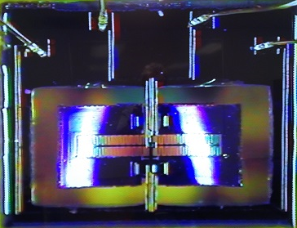
Example: Piezoelectric Cantilevers
Through-wafer hole
5μm-thick
Cantilever “Wing”
IDE Capacitor
Parallel-plate Capacitors
These binary piezoelectric cantilever “wings” resonate at 5kHz. Each has parallel-plate capacitors along the edges and an IDE capacitor down the center. The wings can be excited by one set of capacitors and monitored with the other.

Slide 17
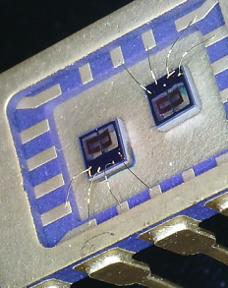
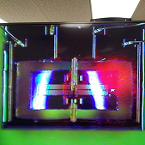
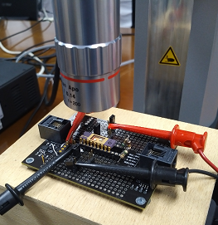
Test Fixturing
LDV laser
Two dice packaged and wire bonded per 18-pin DIP.
Polytec OFV-534 Laser Doppler Vibrometer in displacement mode.

Slide 18
Results: Parallel-Plate Butterfly
Parallel-Plate Actuator
Cantilever tip double butterfly loop driven by perimeter parallel-plate capacitors at 1Hz/20V with 32,000 points.

Slide 19
Results: IDE Butterfly
Interdigitated Electrode Actuator
Butterfly flipped upside down due to IDE field direction.
Cantilever tip double butterfly loop driven by central IDE capacitors. It would be nice to have relays to select automatically between the two sets of capacitors!

Slide 20
Results: Impulse Testing
Electrical impulse applied to cantilever parallel-plate capacitor.
Mechanical Motion
Identify single or multiple resonant frequencies of the Wings cantilever using classic impulse response test: 5 kHz & 46 kHz.

Slide 21
Results: Resonance Testing
5 kHz stimulus
This device has a Q of at least 50 based on its amplitude change during multiple cycles.
Displacement sat multiple frequencies.
Cantilever tip displacement at constant stimulus cycling into the parallel-plate capacitors. Find the Q!

Slide 22
Results: Actuator/Sensor
~0.83pC/μm
~0.6μm
Actuate the cantilever at resonance using one capacitor while sensing the piezoelectric polarization generated in the second capacitor by the tip motion.

Slide 23
Test Requirements
Radiant built these test fixtures for its own research. Radiant’s customers will need to build their own for their research. Radiant foresees the following needs:
Mixed digital and analog signal generation and measurement
Synchronous
Asynchronous
Modern digital communications channels for circuit control
I²C
Digital I/O
USB
Long term test over a range of temperatures
Automated Test Environment (ATE) controlling – and recording – all activity from a single User Interface.

Slide 24
pMEMS Tester Attributes
All existing Precision Multiferroic ferroelectric tests.
Impedance measurement with built-in LCR.
Asynchronous pulse generator with programmable delay triggered by the tester’s already existing SYNC pulse.
Independent DC Bias voltage source
Asynchronous 16-bit voltage measurement.
Frequency counter up to 60 MHz
Parallel Digital I/O port to control pMEMS circuitry while providing power/ground connections from the tester power supply.
I²C Communications Port also supplying remote power.
Temperature chamber with internal user prototyping space and connections to pMEMS tester signals. (Prototype shown earlier.)

Slide 25
NewVision Functions
Advanced Communications and Control
Digital I/O Task with list processing function to control external ADCs, DACs, DSPs, and Gate Arrays from the parallel port.
I²C Task with token-based control functions for communicating with I²C-enabled logic ICs or microprocessor accessory control circuits.
Under consideration → A USB Task for communicating directly between Vision and Arduino boards.
New Vision tasks:
FFT Task
Impulse Response Task
Mechanical Resonance Task
Simultaneous displacement and velocity capture from an LDV
E31 calculation filter

Slide 26
Conclusion
The next few years in ferroelectric technology should be exciting.
New sensors
Stand-alone memory
Electro-optic modulators
Electro-mechanical machinery
All will require complex test jigs for mixed signal and long term reliability testing.
Radiant anticipates the need for fully-integrated Autonomous ATE in the ferroelectrics community:
Test hardware,
External test jigs,
Digital, analog, and environmental controls,
Test analysis, and
Data management.

